Slide 1



Cosserat Rod Models for Soft Robots: When and How to Use Them
Caleb Rucker Associate Professor
CMMI 1427122
IIS 1652588
CMMI 1935278 (EFRI)
Website: https://sites.google.com/site/danielcrucker/
https://sites.google.com/site/danielcrucker/
Notes:
This Transactions on Robotics paper describes the modeling, analysis, and actuation-based force-sensing for Parallel continuum robots. The work was supported by the National Science Foundation through the National Robotics Initiative

Slide 2
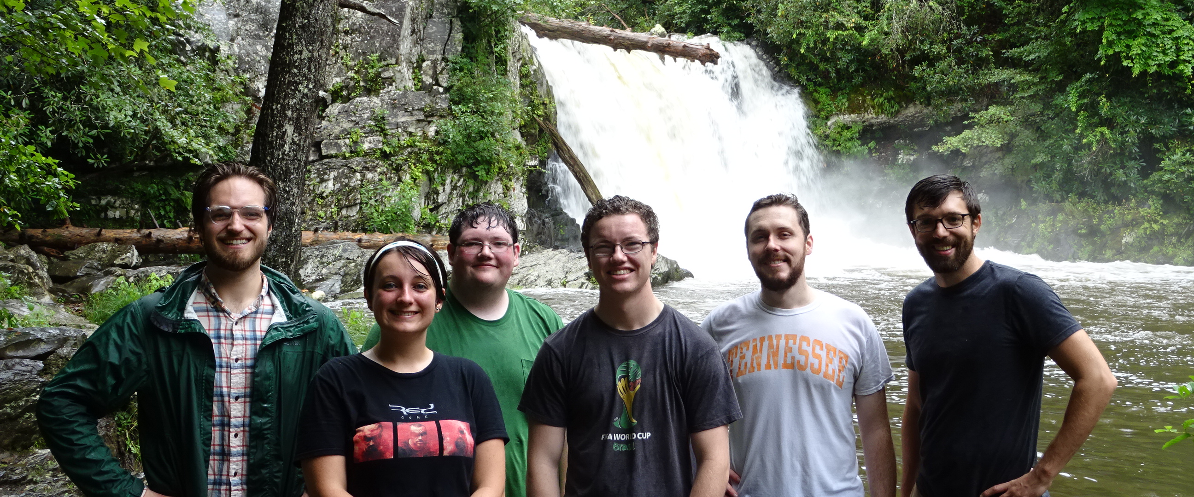
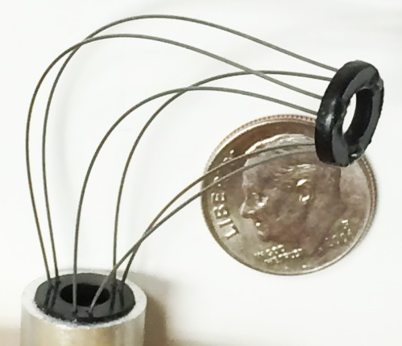







REACH Lab
Modeling, Real-Time Computation, Stability, Control, Sensing
Parallel Continuum Robots
Notched-Tube Robots
Caroline Black
Jake Childs
Ryan Ponten
John Till
Kaitlin Oliver-Butler
Vince Aloi

Slide 3
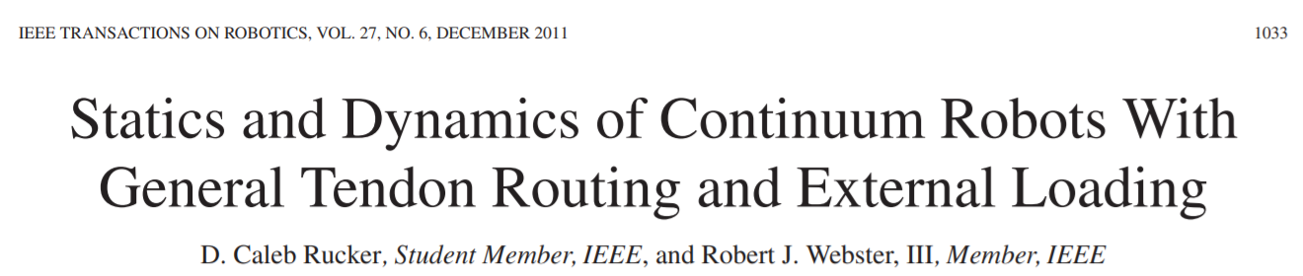
Outline
What: Intro to Cosserat Rod Models
Why and When: Advantages and Limitations
How: Numerical Solution
How: Tendon Actuation
Dynamics & other recent highlights

Slide 4


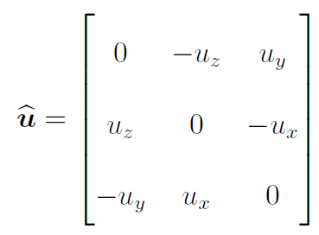




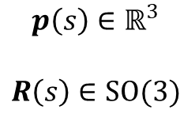

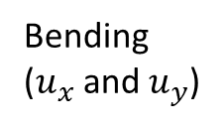



What: Intro to Cosserat Rod Models
A Cosserat rod model Describes the 3D position and orientation of a cross section as a function of a reference length (s ) (and time (t ) if dynamic)
Allows bending, torsion, shear, and extension/compression
If shear and extension are not allowed, it is a Kirchhoff rod:
$$p\left(s\right)∈ℝ^{3}$$
$$R\left(s\right)∈SO(3)$$
$$s$$
$$x$$
$$z$$
$$y$$
Torsion ($u_{z}$)
Extension ${(v}_{z})$
Bending
($u_{x}$ and $u_{y}$)
Shear ($v_{x}$ and $v_{y}$)

Slide 5

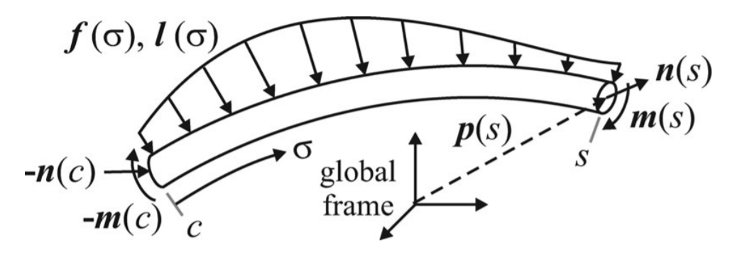
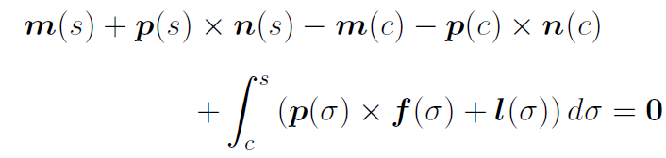


What: Intro to Cosserat Rod Models
n – internal force
m – internal moment
f – external distributed force
l – external distributed moment
Geometrically Exact: equilibrium is written in the deformed state, no small-angle approximations
Force Balance
Moment Balance
Differentiating these with respect to s, we obtain the
equations of equilibrium for the special theory of Cosserat rods
S.S. Antman, Nonlinear Problems of Elasticity
Notes:
Note – covering statics first, dynamics later

Slide 6
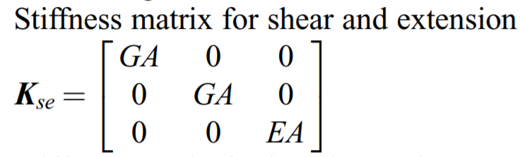
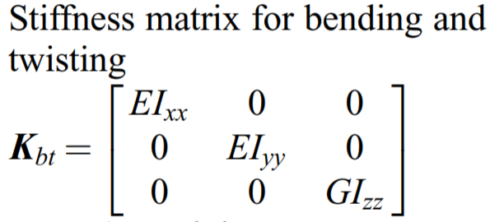
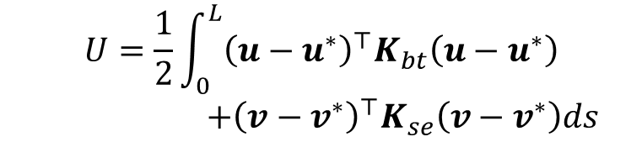




What: Intro to Cosserat Rod Models
A constitutive law relates the kinematics to the forces, moments, and stored energy. Below is the standard linear one, but nonlinear ones can also be used.
  *denotes kinematic variable describing the stress-free reference state. For an initially straight rod,
$$m={RK}_{se}(u−u^{∗})$$
$$u^{∗}=\left[\begin{aligned}0 \\ 0 \\ 0\end{aligned}\right]$$
$$v^{∗}=\left[\begin{aligned}0 \\ 0 \\ 1\end{aligned}\right]$$
Total Elastic Energy Stored
$$n={RK}_{se}(v−v^{∗})$$
$$U=\frac{1}{2}\int_{0}^{L}{{\left(u−u^{∗}\right)}^{⊤}K_{bt}\left(u−u^{∗}\right)}$$
$+{\left(v−v^{∗}\right)}^{⊤}K_{se}\left(v−v^{∗}\right)ds$
Note: The model remains nonlinear and good for large deflections/rotations
even when a linear constitutive law is used. It is like co-rotational linear elasticity.

Slide 7
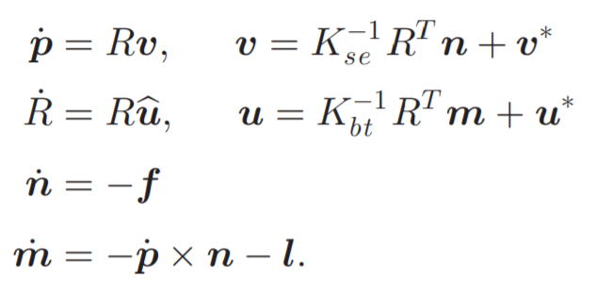
What: Intro to Cosserat Rod Models
Results in a system of ODE’s in s :
And usually a boundary value problem:
Can alternatively use quaternions
D. C. Rucker. Integrating Rotations using Non-Unit Quaternions. IEEE Robotics and Automation Letters, vol. 3, no. 4, pp. 2979-2986, June 2018
Can alternatively write the force/moment equations in the body frame
Position and orientation known at s=0 . Internal force and moment unknown.
Internal force and moment known at s=L . Position and orientation unknown

Slide 8
Why and When: Advantages & Limitations
Why?
  Accurately captures the significant effects in large deflection/rotation cases
  Usually orders of magnitude faster than a full 3D elasticity model, meshed and solved with FEM
  Can be cast in traditional forms analogous to those of rigid-link serial robots
  5 stiffness parameters
    Can often be derived from first principles, then further calibrated based on kinematic data
    Flexible – can be fit to FEM simulation or
    springs, bellows, origami, etc., and “soft” materials.
When?
  Deformation dominated by bending, torsion, shear, extension, varying along a single dimension (s)
  Slenderness: L/r > 5 … or so (depending on the case and accuracy required)
  Cross sections remain planar and do not change shape or size
  Strains small enough for the chosen constitutive law
  Use Kirchhoff if shear & extension are negligible

Slide 9





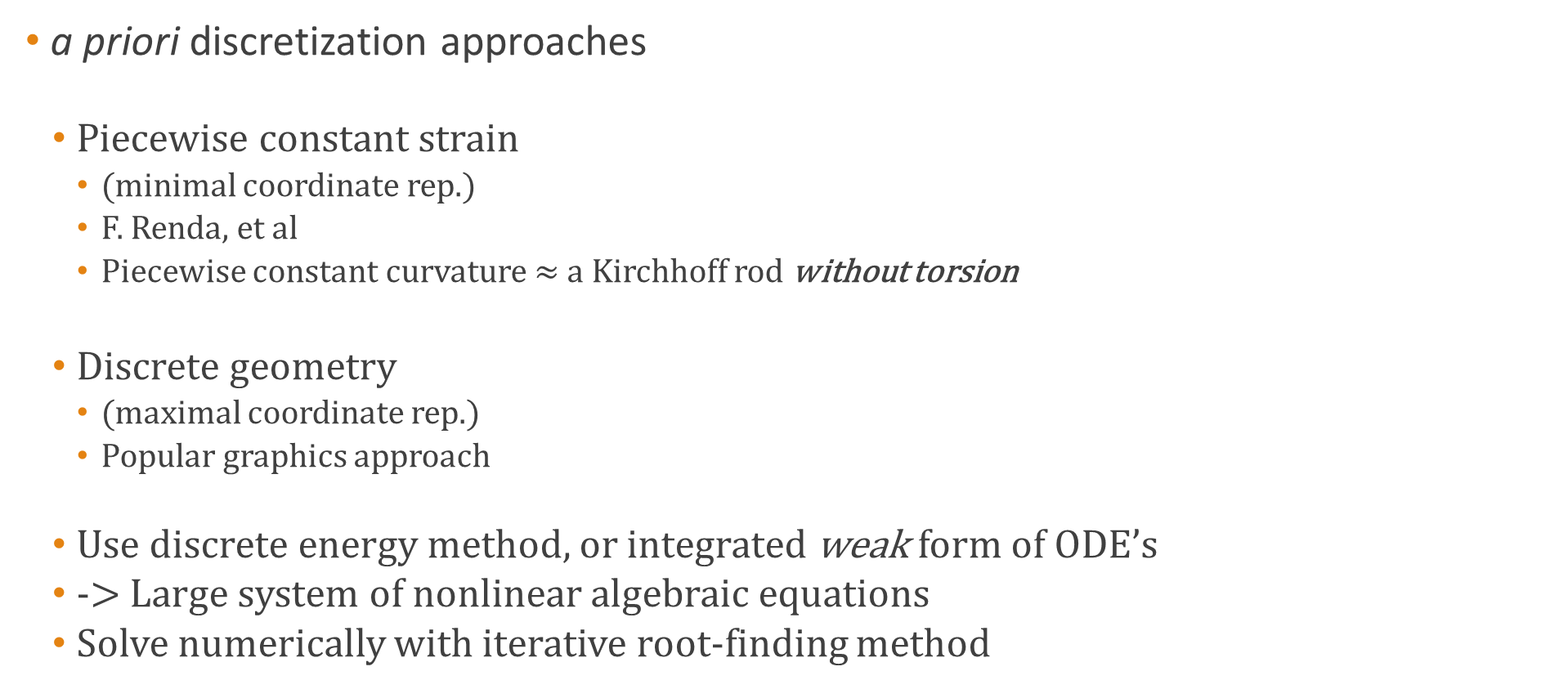







How: Numerical Solution
a priori discretization approaches
  Piecewise constant strain
    (minimal coordinate rep.)
    F. Renda, et al
    Piecewise constant curvature $≈$ a Kirchhoff rod without torsion
  Discrete geometry
    (maximal coordinate rep.)
    Popular graphics approach
  Use discrete energy method, or integrated weak form of ODE’s
  -> Large system of nonlinear algebraic equations
  Solve numerically with iterative root-finding method
$$u_{3}$$
$$u_{1}$$
$$u_{2}$$
$$v_{3}$$
$$v_{1}$$
$$v_{2}$$
$$p_{3}$$
$$p_{1}$$
$$p_{2}$$
$$R_{3}$$
$$R_{1}$$
$$R_{2}$$

Slide 10
How: Numerical Solution
Or use a shooting method
  Consider the same ODE as an initial value problem (IVP)
  Use IVP integrator (Dormand-Prince, RK4, etc.)
  Update any unknown proximal conditions until the distal conditions are satisfied.
Pros
  Compact notation: No need for a priori discretization
  The nonlinear system to be solved is now much smaller
  Spatial accuracy of the solution is high and scales well (high-order)
  Adaptive step-size integrators can resolve high curvatures where needed.
  Real-time fast (multi-kHz rates in a compiled language)
Cons
  Convergence can be less stable, but we usually have a good starting guess from previous.
  Does not offer a natural minimal coordinate representation (useful for control design)
  Contact handling is easier with discrete maximal coordinates

Slide 11
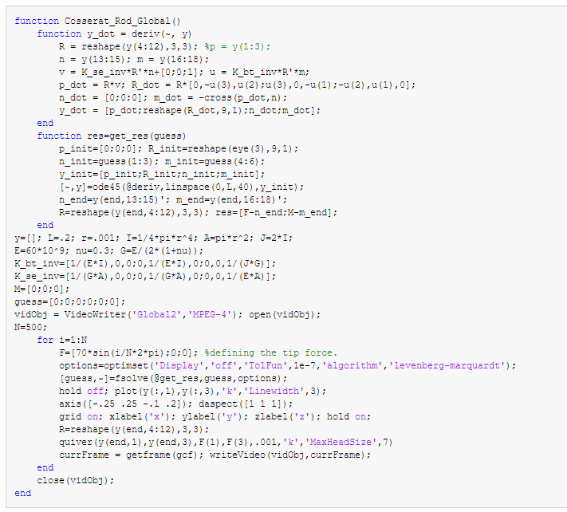
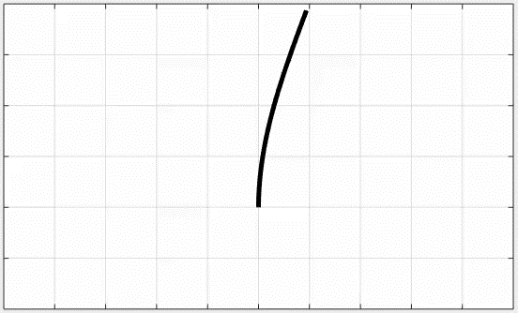
Example
A global force with sinusoidal magnitude

Slide 12
Example

Slide 13
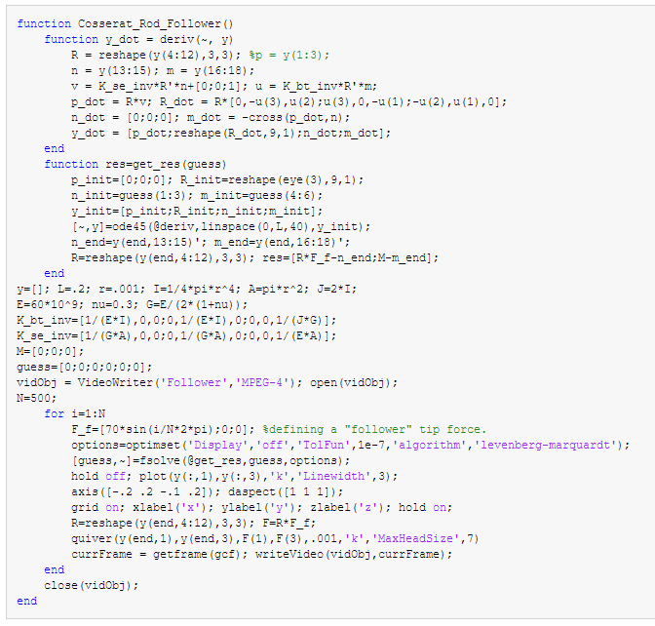
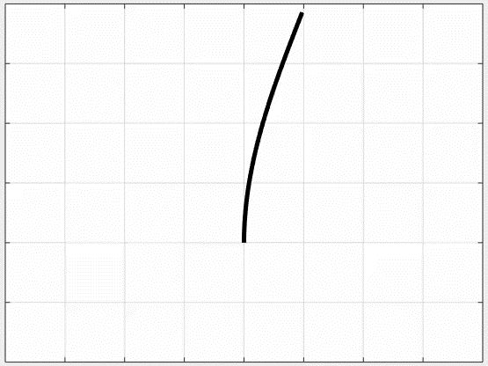
Example
A follower force* with sinusoidal magnitude
*constant direction in local tip frame. The problem can be converted to an IVP in this special case.

Slide 14
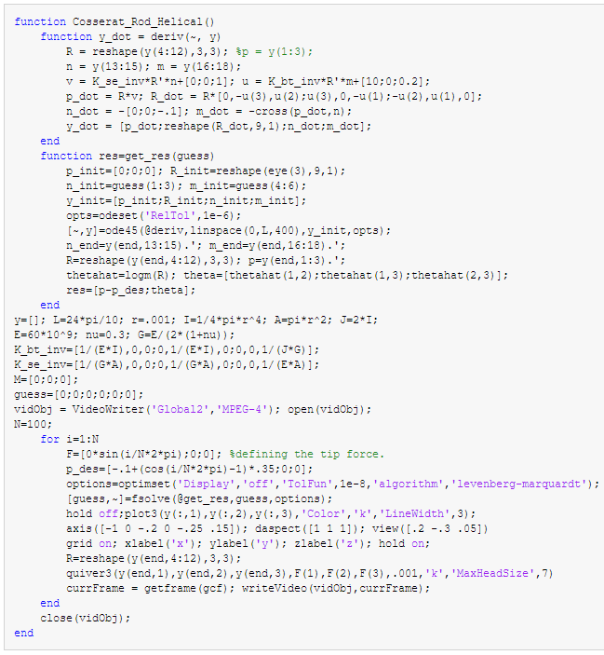
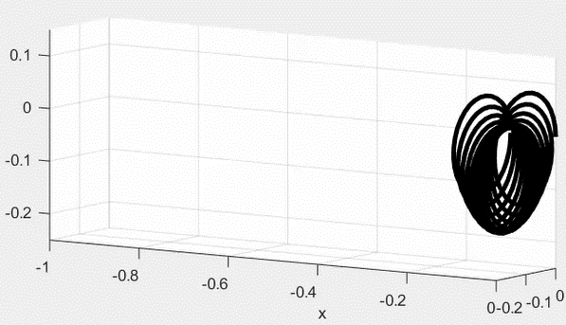
Example
Coil Spring (N=12) under gravity load*
Coils modeled by pre-curvature and pre-torsion
*A non-shooting approach with a priori discretization is probably more suitable for extreme cases like this. Though the system size is larger, it is better conditioned, and the solution is numerically more stable. Alternatively, one can use multi-shooting methods.

Slide 15
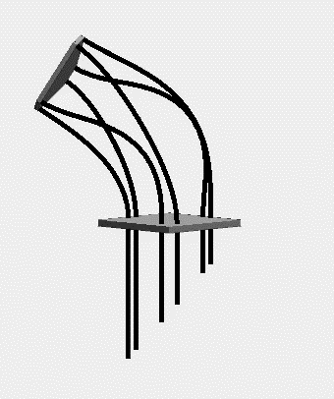
Example
Parallel Continuum Robots
Independent rods coupled at the base and the end-effector
Solve as a single large shooting problem
Inverse kinematics is easy to solve the same way
Elastic Stability
  The Cosserat ODEs are the first-order necessary conditions for equilibrium
  Evaluate second-order sufficient conditions (conjugate point test) to determine if a solution is stable
C. B. Black, J. Till, and D. C. Rucker. Parallel Continuum Robots: Modeling, Analysis, and Actuation-Based Force Sensing. IEEE Transactions on Robotics, vol. 34, no. 1, pp. 29-47, February 2018.
J. Till and D. C. Rucker. Elastic Stability of Cosserat Rods and Parallel Continuum Robots. IEEE Transactions on Robotics, vol. 33, no. 3, pp. 718-733, June 2017.

Slide 16
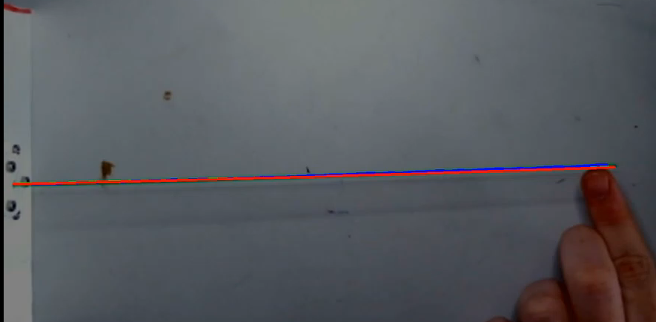
Example: Force Estimation
V.A. Aloi and D.C. Rucker, Estimating Loads Along Elastic Rods. IEEE/RAS International Conference on Robotics and Automation (ICRA), 2867-2873, 2019.

Slide 17
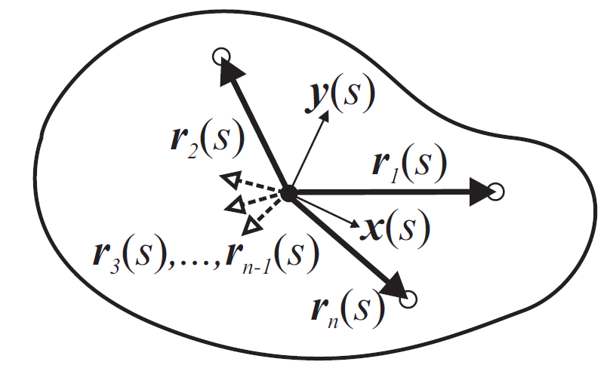


How: Tendon Actuation
“Space-time tells matter how to move; matter tells space-time how to curve” – John Wheeler
The backbone tells the tendons where to be; the tendons tell the backbone how to curve.

Slide 18


How: Tendon Actuation
“Space-time tells matter how to move; matter tells space-time how to curve” – John Wheeler
The backbone tells the tendons where to be; the tendons tell the backbone how to curve.
?
?

Slide 19
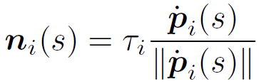
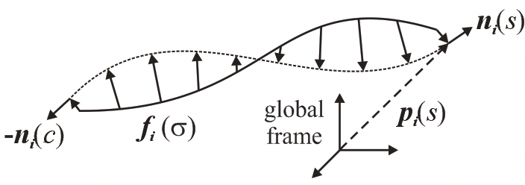

How: Tendon Actuation
“Space-time tells matter how to move; matter tells space-time how to curve” – John Wheeler
The backbone tells the tendons where to be; the tendons tell the backbone how to curve.
The force a tendon exerts on its channel depends on the deformed channel shape, which depends on the curvature of the backbone.
Cosserat String Model

Slide 20
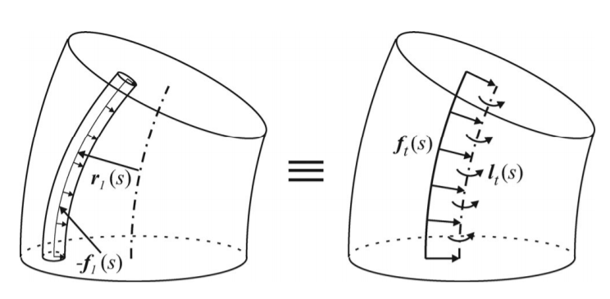
How: Tendon Actuation
“Space-time tells matter how to move; matter tells space-time how to curve” – John Wheeler
The backbone tells the tendons where to be; the tendons tell the backbone how to curve.
The tendon forces and moments on the backbone are nonlinear functions of u and v
But they are linear in the derivatives of u and v

Slide 21
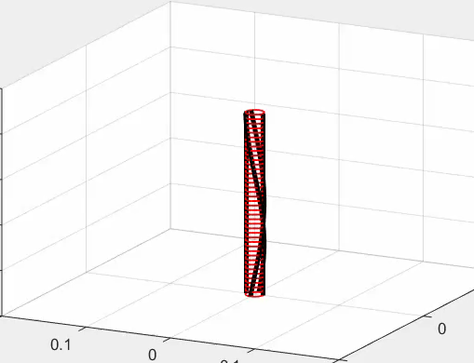
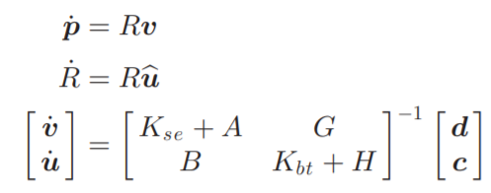
How: Tendon Actuation
Coupled model in explicit form:
A, B, G, H are functions of tendon tensions and tendon routing paths
c and d are functions of external loading
all are functions of u and v

Slide 22
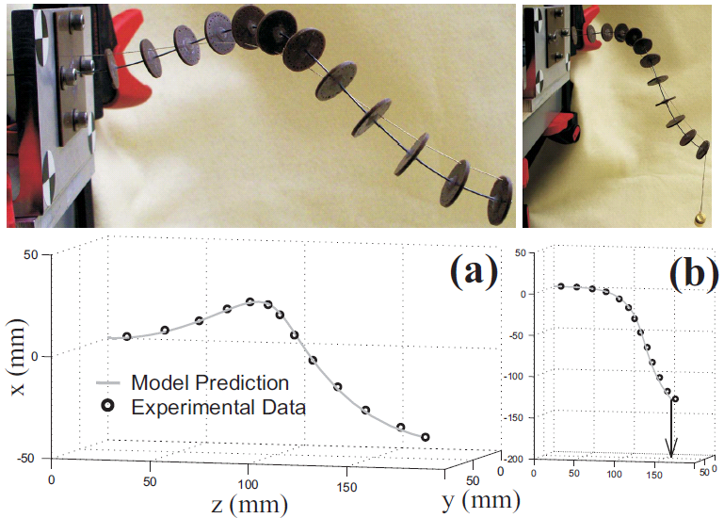
How: Tendon Actuation
Experimental Validation

Slide 23
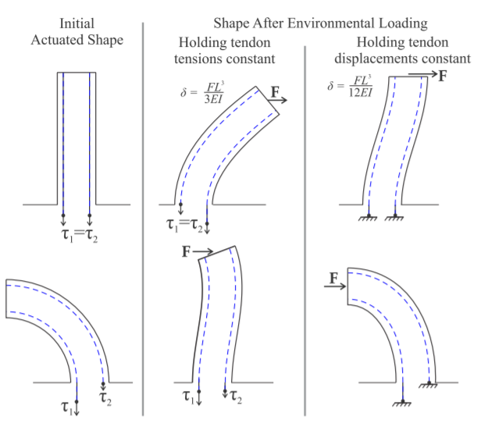
Further tendon work
What happens if the tendon displacements are prescribed instead of the tensions?
How does tendon routing path affect robot stiffness?
How do we incorporate possible tendon stretch and slack into the model?
K. Oliver-Butler, J. Till, and D. C. Rucker. Continuum Robot Stiffness Under External Loads and Prescribed Tendon Displacements. IEEE Transactions on Robotics, vol. 35, no. 2, pp. 403-419, April 2019.

Slide 24
Dynamics
John Till, Vincent Aloi, and Caleb Rucker. “Real-Time Dynamics of Soft and Continuum Robots Based on Cosserat Rod Models.” The International Journal of Robotics Research 38, no. 6 (May 2019): 723–46.

Slide 25
Approach
Cosserat PDE system
Approximate all time derivatives with an implicit method (e.g. BDF2)
ODE Boundary Value Problem in Arc Length
Integrate the arc length derivatives with a high-order method (e.g. RK4)
Solve BVP with shooting method (already used in static models)
Numerical Solution at each timestep

Slide 26
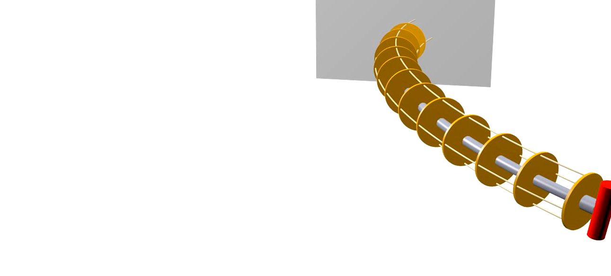
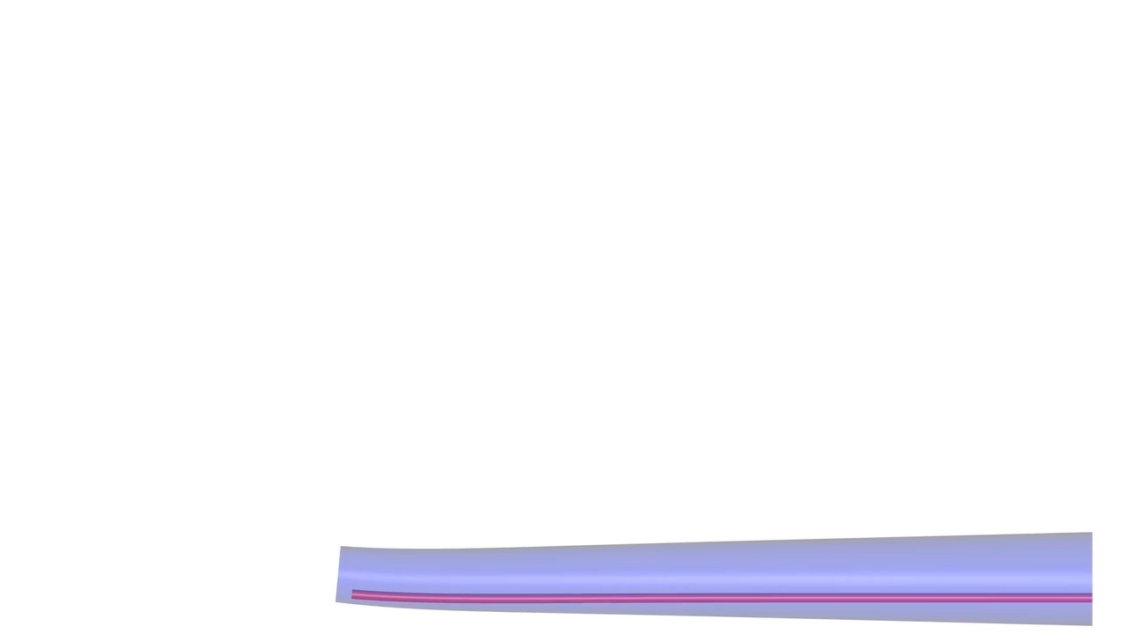
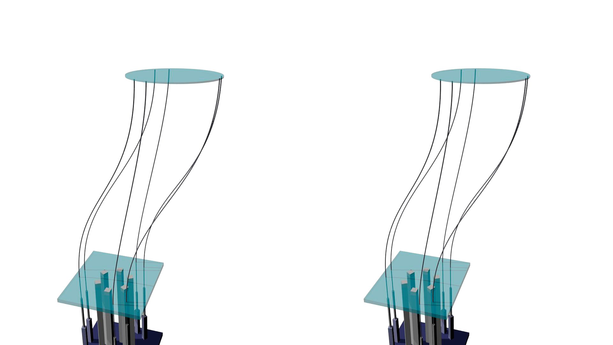
John Till, Vincent Aloi, and Caleb Rucker. “Real-Time Dynamics of Soft and Continuum Robots Based on Cosserat Rod Models.” The International Journal of Robotics Research 38, no. 6 (May 2019): 723–46.
Notes:
The proposed model is accurate, efficient, and generalizable to a wide class of robots. Although PDE methods are often quite involved, we believe the discretization strategy here is relatively simple.

Slide 27
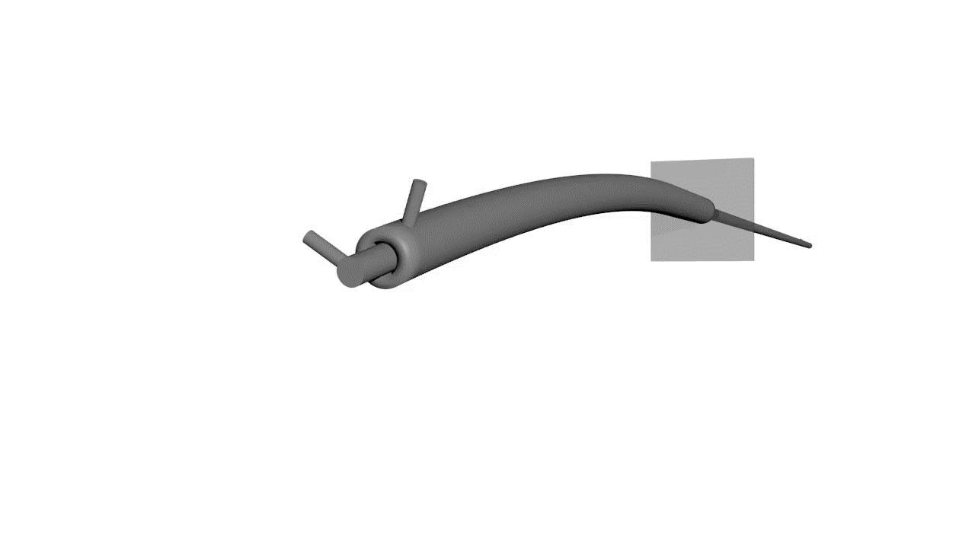
Concentric-Tube Snap Dynamics
J. Till, V. Aloi, K.E. Riojas, P.L. Anderson, R.J. Webster III, and C. Rucker, A Dynamic Model for Concentric Tube Robots. IEEE Transactions on Robotics, doi: 10.1109/TRO.2020.3000290.

Slide 28
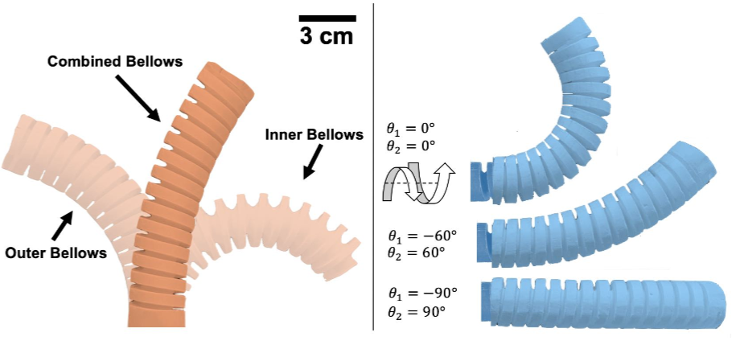
Concentric Precurved Bellows
J.A. Childs and C. Rucker. Concentric Precurved Bellows: New Bending Actuators for Soft Robots. IEEE Robotics and Automation Letters, vol. 5, no. 2, 2020.
Eliminates torsional lag and “snapping” instability

Slide 29
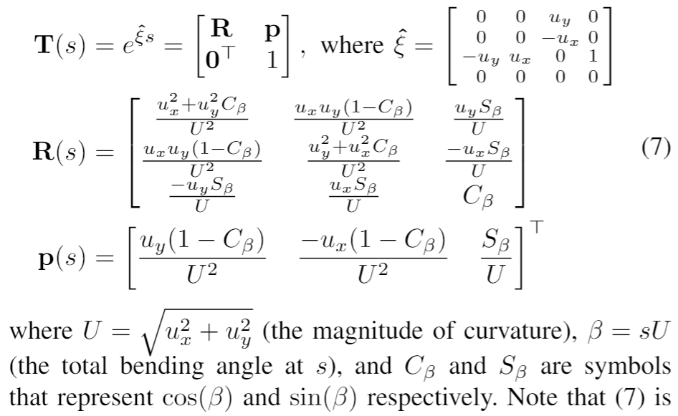
Concentric Precurved Bellows
A Piecewise Constant-Curvature parameterization without the polar singularity
  (see also Della Santina RA-L 2020)
Widely used parameterization
  Curvature magnitude
  Polar angle of curvature vector
  Length
Better Alternative
  X curvature
  Y curvature
  Length

Slide 30
REACH Lab
Modeling, Real-Time Computation, Stability, Control, Sensing
Parallel Continuum Robots
Notched-Tube Robots
Caroline Black
Jake Childs
Ryan Ponten
John Till
Kaitlin Oliver-Butler
Vince Aloi

